Slide 1
Cognitive Audio
Activity-Sensitive Audio for Stimulatory Cognitive Control
Github link (project inwork)

Slide 2
Cognitive-Stimulative Experience
Become the instrument: create live audio experience with activity-linked, semantically-tuned live audio streaming…
Ex: concentrate on work with sensitive music & inhibitory filtration.
Control life experience with finetuned audio-cognitive congruence

Slide 3
Related Work
Sensory Processing in Autism Spectrum Disorders (Pediatric Research Foundation)
Prof. DiCarlo’s work on human visual-perceptive control
State of Generative Music & Audio-Generative Architectures
MIT Media Lab’s Semantic Synth Programming
NVIDIA Triton Temporal Fusion Transformer Architecture (OS)
Mesgarani N.A.P. Lab work on BCI-Augmented Attentional Control

Slide 4
General Architecture
Static Data
(pers. Info)
Encoder
Decoder
(context-aware generative)
(nearest-neighbor
+ glue)
Activity Data
(HR, Accel)
(Audio)
Temperature Control
Activity Semantics
Activity Context
(Semantic info, HR, FFT?)
User Prompt Info
(Maybe Audio)
Audio Stream
Encoder Input Notes
maybe incorporate video, audio (model impl.)
Consider surprise-style query trigger
Decoder Input Notes
Heartrate Info or FFT?
prediction length impl
glue method with segment retrieval
Can pregenerate segments or semantics

Slide 5
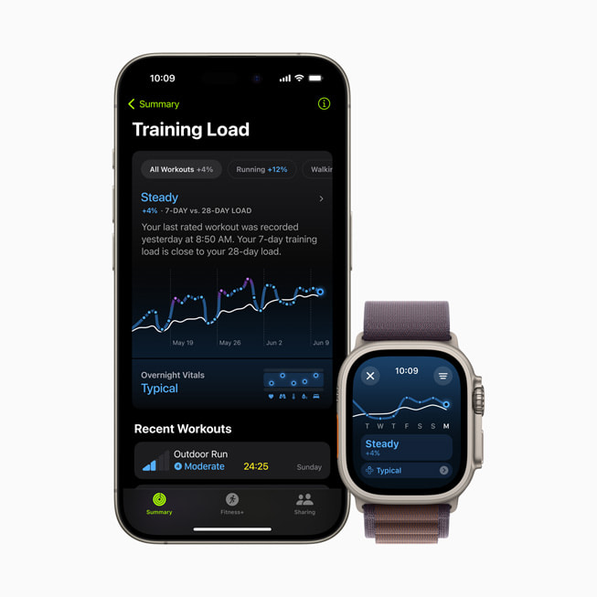
Activity Data Encoder
Wearable Sensor Data (Apple Watch
heartrate, gyro, accel. (also magnet., altim.)
Audio Data
See Meta MusicGen Encoder; consider pretraining cost savings, finetuning & cross-attentive / TFT style multimodal
Compare with visual perturbation modeling, esp. inverse problem, research needs, academic grounding
Compute intensity? Latency effects?
Train ZSL Classifier(ex) / import preexisting classifier(ifexist).
Longterm; RLHF policy improvements and UI semantic prompt eng.
Gemma-type LLM to generate train-of-thought type semantics, or simply list-of-words input
(currently using Qwen-2B, possibly switch to CLIP)

Slide 6
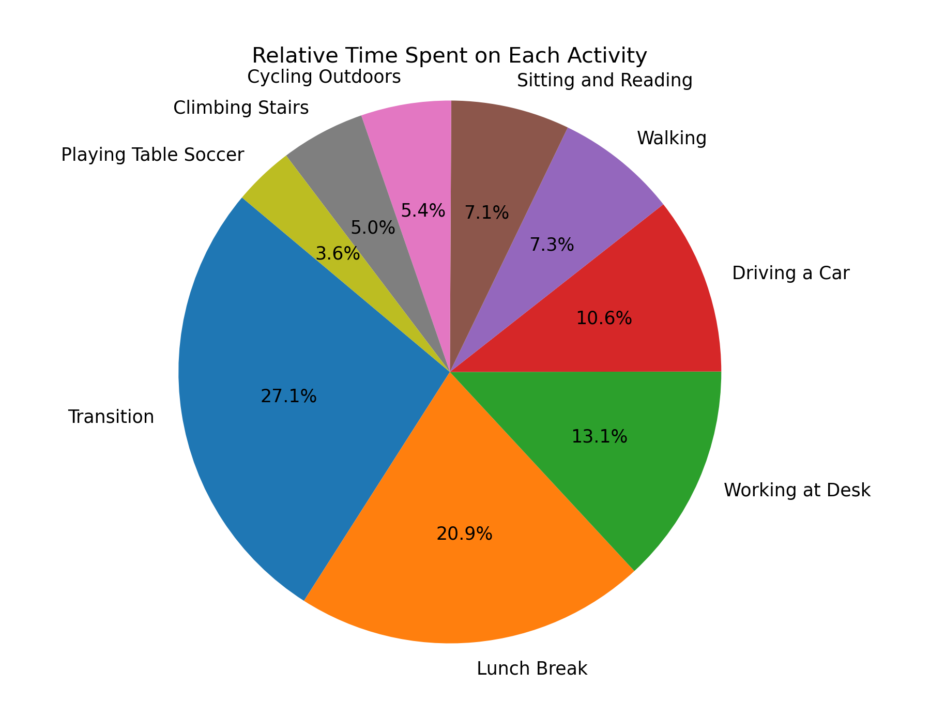
UC Irvine PPG Dataset (heartrate, 64Hz wrist accel, activity)
128k sec of activity data;
15 subjects, 9 activities (including transition)
https://archive.ics.uci.edu/dataset/495/ppg%2Bdalia?

Slide 7
“Latent Space” – Audio Model Input
Run activity info + existing prompt into audio input..
User interface controls:
Dials changing decoder input prompt, latent output temperature for customization

Slide 8
Audio Decoder
Audio model with latent / semantic context input
Context shifting, realtime indicators for latency management
Finetuned/pretrained generative music model – investigate input, latency
Cross-attentive / TFT-type architecture (multiple context sources)
Synthesizer-type audio control (see MIT lab)
Pretraining/RL with larger multimodal model for labelling & task convergence
K-nn style segmented dataset streaming
Smaller “glue” model trained to transition between segments
Ex grab beat drop & stream in

Slide 9
Notes
Look into game music control
Inhibitory (ex ANC) vs Excitatory stimulus
Product Research & Development Stage – contact liam.mchugh@columbia.edu for more details

